Slide 1

Derivative Derivative of a Power
RCET 0264 Introductory Calculus
Tim Leishman

Slide 2

Derivative of a Power
Example 1:
$$y=\frac{{(x^{3}+2)}^{4}}{({4x}^{2}−3x)}$$
$\frac{dy}{dx}=\frac{4 {\left(x^{3}+2\right)}^{3}\left(3x^{2}\right)\left({4x}^{2}−3x\right)−(1)(1)(8x−3){(x^{3}+2)}^{4}}{{({4x}^{2}−3x)}^{2}}$
$\frac{dy}{dx}=$ $\frac{{\left(x^{3}+2\right)}^{3}[\left(12x^{2}\right)\left({4x}^{2}−3x\right)−\left(8x−3\right){\left(x^{3}+2\right)}^{1}]}{{({4x}^{2}−3x)}^{2}}$
$\frac{dy}{dx}=\frac{{\left(x^{3}+2\right)}^{3}[\left({48x}^{4}−36x^{3}\right)−\left(8x^{4}+16x−3x^{3}−6\right)]}{{({4x}^{2}−3x)}^{2}}$
$\frac{dy}{dx}=$ $\frac{{\left(x^{3}+2\right)}^{3}[{48x}^{4}−36x^{3}−8x^{4}−16x+3x^{3}+6]}{{({4x}^{2}−3x)}^{2}}$
$\frac{dy}{dx}=$ $\frac{{\left(x^{3}+2\right)}^{3}[{40x}^{4}−33x^{3}−16x+6]}{{({4x}^{2}−3x)}^{2}}$
Quotient Rule:
The derivative of a quotient is solved by taking the derivative of the numerator multiplied by the denominator. Then subtracting the derivative of the denominator multiplied by the numerator. And finally, dividing everything by the denominator squared.

Slide 3
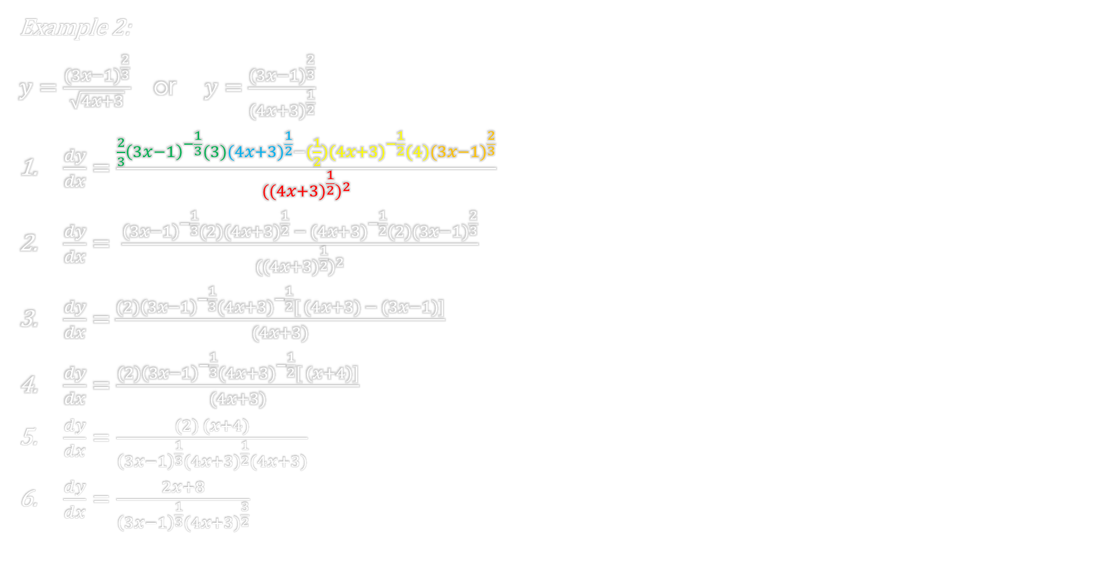
Derivative of a Power
Example 2:
$y=\frac{{(3x−1)}^{\frac{2}{3}}}{\sqrt{4x+3}}$ or $y=\frac{{(3x−1)}^{\frac{2}{3}}}{({4x+3)}^{\frac{1}{2}}}$
$\frac{dy}{dx}=$ $\frac{{\frac{2}{3}\left(3x−1\right)}^{−\frac{1}{3}}(3)({4x+3)}^{\frac{1}{2}}−(\frac{1}{2})({4x+3)}^{−\frac{1}{2}}(4){(3x−1)}^{\frac{2}{3}}}{{(({4x+3)}^{\frac{1}{2}})}^{2}}$
$\frac{dy}{dx}= \frac{{\left(3x−1\right)}^{−\frac{1}{3}}(2)({4x+3)}^{\frac{1}{2}} − ({4x+3)}^{−\frac{1}{2}}(2){(3x−1)}^{\frac{2}{3}}}{{(({4x+3)}^{\frac{1}{2}})}^{2}}$
$\frac{dy}{dx}=$ $\frac{(2){\left(3x−1\right)}^{−\frac{1}{3}}({4x+3)}^{−\frac{1}{2}}[ (4x+3) − (3x−1)]}{(4x+3)}$
$\frac{dy}{dx}=$ $\frac{(2){\left(3x−1\right)}^{−\frac{1}{3}}({4x+3)}^{−\frac{1}{2}}[ (x+4)]}{(4x+3)}$
$\frac{dy}{dx}=$ $\frac{(2) (x+4)}{{\left(3x−1\right)}^{\frac{1}{3}}({4x+3)}^{\frac{1}{2}}(4x+3)}$
$\frac{dy}{dx}=$ $\frac{2x+8}{{\left(3x−1\right)}^{\frac{1}{3}}({4x+3)}^{\frac{3}{2}}}$
Quotient Rule:
The derivative of a quotient is solved by taking the derivative of the numerator multiplied by the denominator. Then subtracting the derivative of the denominator multiplied by the numerator. And finally, dividing everything by the denominator squared.

Slide 4
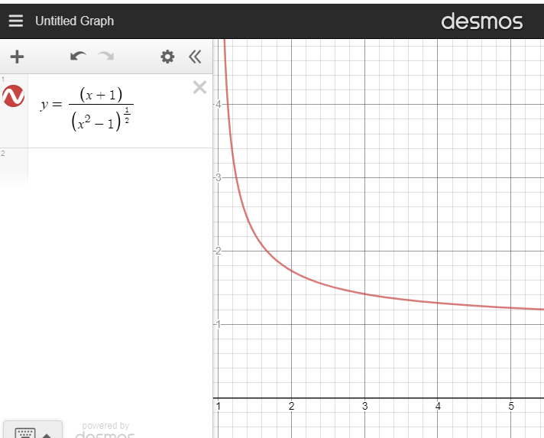

Derivative of a Power
Example 3: Find the velocity of an object after 3 seconds of travel where the distance S (in meters) traveled by the object is given by:
$$s=\frac{t+1}{\sqrt{t^{2}−1}}$$
$\frac{ds}{dt}=$ $\frac{(1)(1)(1)({t^{2}−1)}^{\frac{1}{2}}−(\frac{1}{2})({t^{2}−1)}^{−\frac{1}{2}}(2t)(t+1)}{{(\sqrt{t^{2}−1})}^{2}}$
$\frac{ds}{dt}=$ $\frac{({t^{2}−1)}^{\frac{1}{2}}−(\frac{1}{2})({t^{2}−1)}^{−\frac{1}{2}}(2t^{2}+2t)}{(t^{2}−1) }$
$\frac{ds}{dt}=$ $\frac{({t^{2}−1)}^{−\frac{1}{2}}[(t^{2}−1)−(\frac{1}{2})\left(2t^{2}+2t\right)]}{(t^{2}−1) }$
$\frac{ds}{dt}=$ $\frac{({t^{2}−1)}^{−\frac{1}{2}}[(t^{2}−1)−t^{2}−t]}{(t^{2}−1) }$
$\frac{ds}{dt}=$ $\frac{({t^{2}−1)}^{−\frac{1}{2}}[−1−t]}{(t^{2}−1) }$
$\frac{ds}{dt}=$ $\frac{[−1−t]}{({t^{2}−1)}^{\frac{1}{2}}(t^{2}−1) }$
$\frac{ds}{dt}=$ $\frac{−t−1}{({t^{2}−1)}^{\frac{3}{2}} }$

Slide 5

Derivative of a Power
Example 3: Find the velocity of an object after 3 seconds of travel where the distance S (in meters) traveled by the object is given by:
$$s=\frac{t+1}{\sqrt{t^{2}−1}}$$
$\frac{ds}{dt}=$ $\frac{−t−1}{({t^{2}−1)}^{\frac{3}{2}} }$
${S^{′}}_{(3sec)}=Velocity of the object after 3seconds$
${S^{′}}_{(3sec)}=$ $\frac{−(3)−1}{({3^{2}−1)}^{\frac{3}{2}} }=\frac{−4}{22.627}$
${S^{′}}_{(3sec)}=−173.777x{10}^{−3}meters/second$

Slide 6
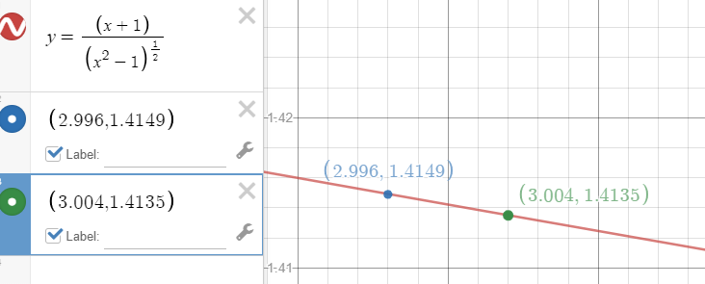
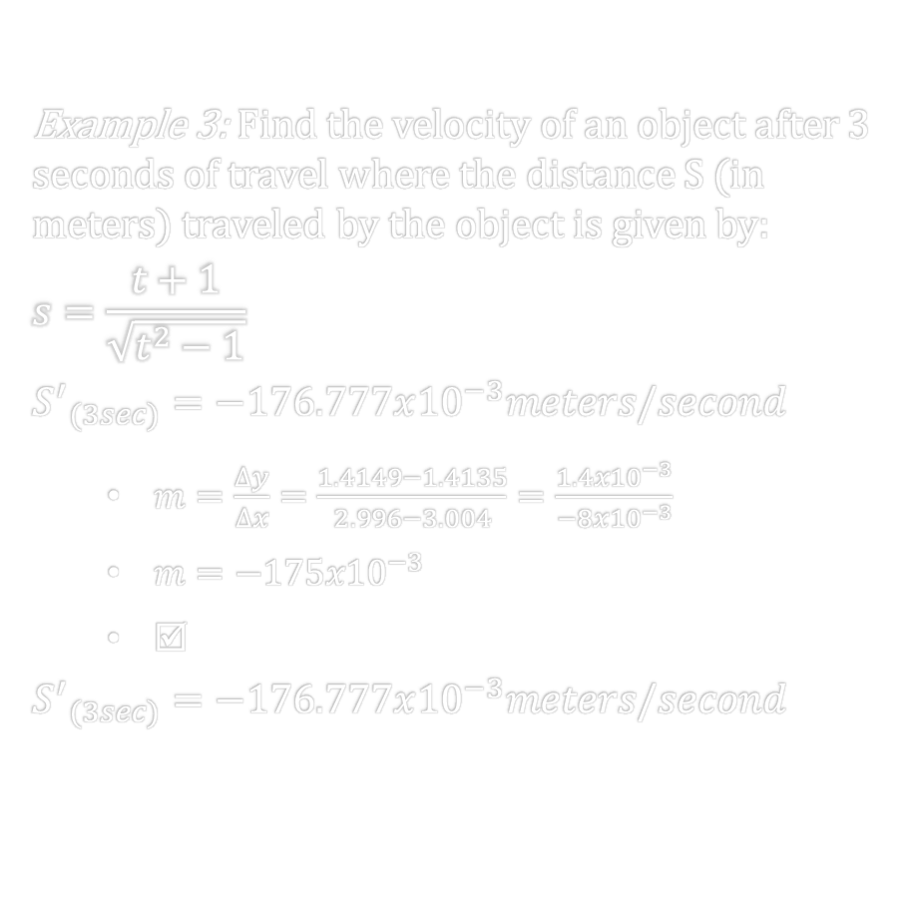
Derivative of a Power
Example 3: Find the velocity of an object after 3 seconds of travel where the distance S (in meters) traveled by the object is given by:
$$s=\frac{t+1}{\sqrt{t^{2}−1}}$$
$${S^{′}}_{(3sec)}=−176.777x{10}^{−3}meters/second$$
$m=\frac{∆y}{∆x}=\frac{1.4149−1.4135}{2.996−3.004}=\frac{1.4x{10}^{−3}}{−{8x10}^{−3}}$
$m=−175{x10}^{−3}$
☑
$${S^{′}}_{(3sec)}=−176.777x{10}^{−3}meters/second$$

Slide 7
References:
Ewen, D., Gary, J. S., & Trefzger, J. E. (2005). Technical calculus. Upper Saddle River, NJ: Pearson/Prentice Hall.
Richmond, A. E., & Hecht, G. W. (1995). Calculus for electronics. New York: Glence.
https://www.desmos.com

